Slide 1
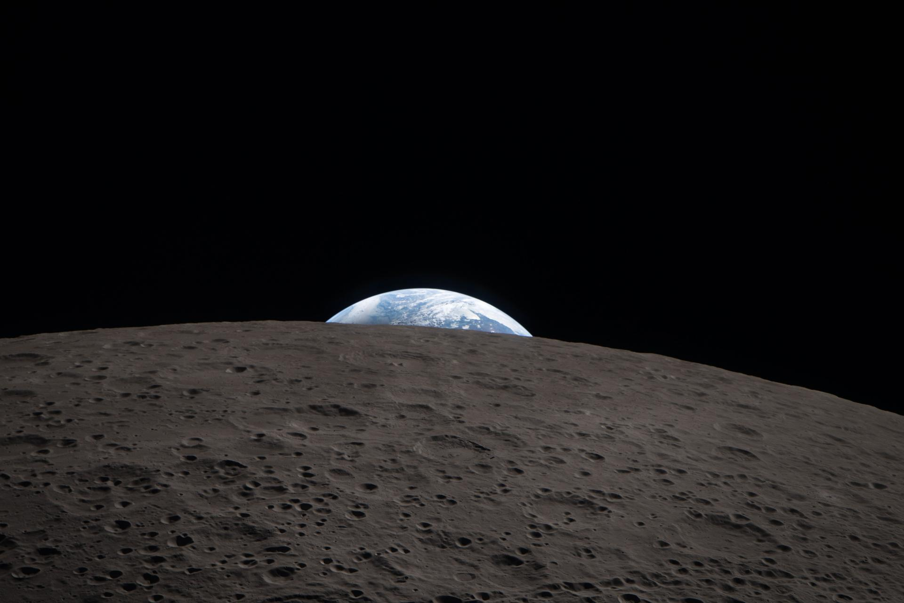



MISSION BRIEF — 2026
SAN FRANCISCO, CA
Chargebotc
EMPOWERING ROBOTS ON THE MOON
BACKED BY
anis@chargebotic.com · chargebotic.com
01 / 09

Slide 2
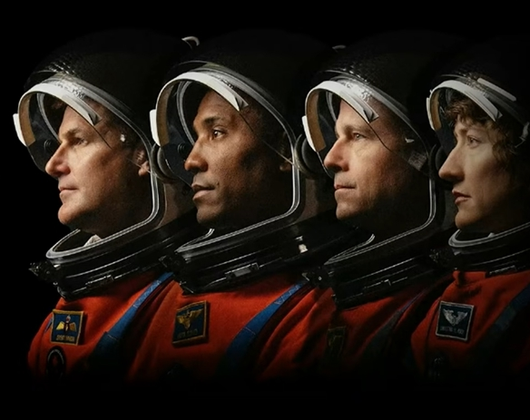
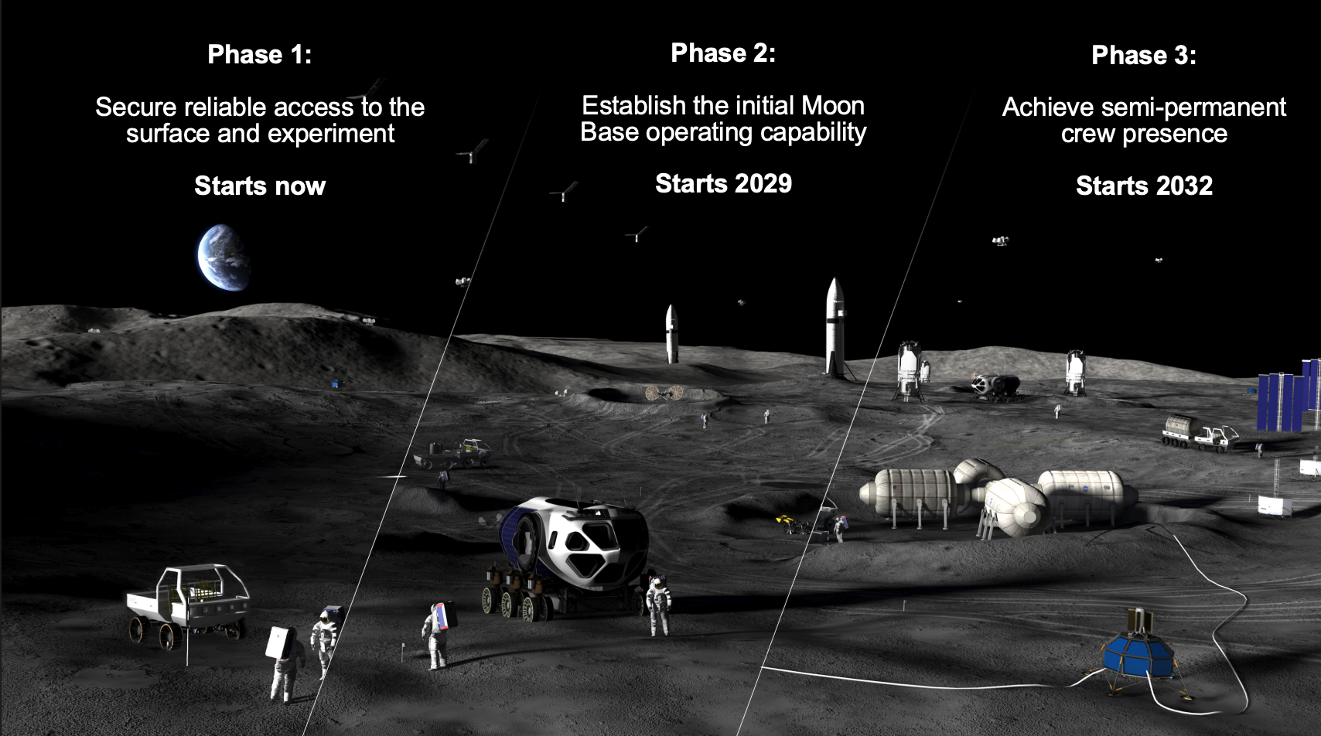
HAZARD — 01
THE ENERGY BOTTLENECK
Energy kills lunar missions.
Humanity must establish a lunar presence within 5 years. Robots get there first but without reliable power, they freeze, stall, and strand operations within days.
14 DAYS
Max rover survival during lunar night
−173 °C
Temperature extremes that kill batteries
LIMITED
Exploration range tethered to landers
CHARGEBOTIC
anis@chargebotic.com · chargebotic.com

Slide 3
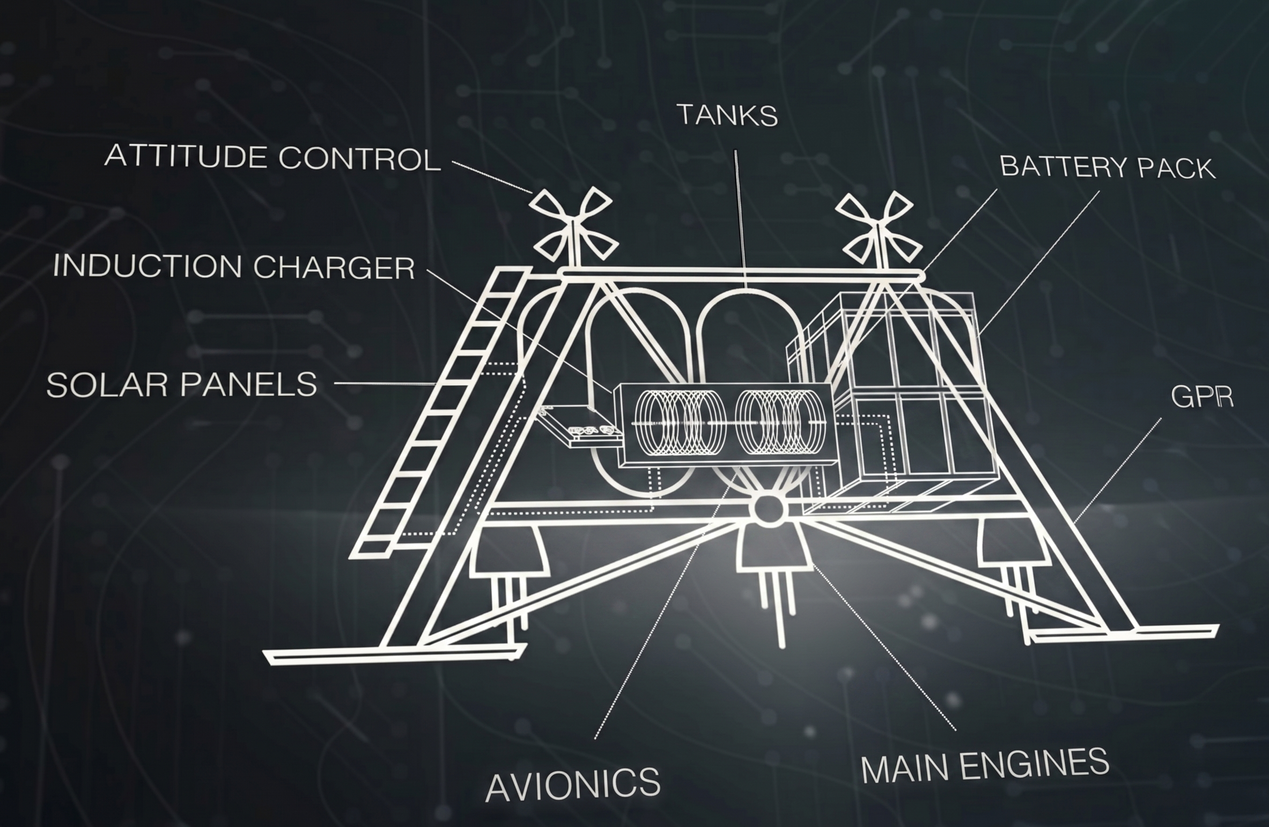
THE SOLUTION
MoonPAD drones
Deploy highly mobile MoonPad hoppers over the lunar South Pole in a single launch architecture
Hoppers land themselves and operate independently Foldable structure compact stowed, full range deployed
Battery payload up to 50 kWh delivered per trip
500 km total range
Hosts multiple payloads:
Bi-directional induction charging pad
Survive-the-night energy-banking demonstration
CHARGEBOTIC
anis@chargebotic.com · chargebotic.com
03 / 09

Slide 4
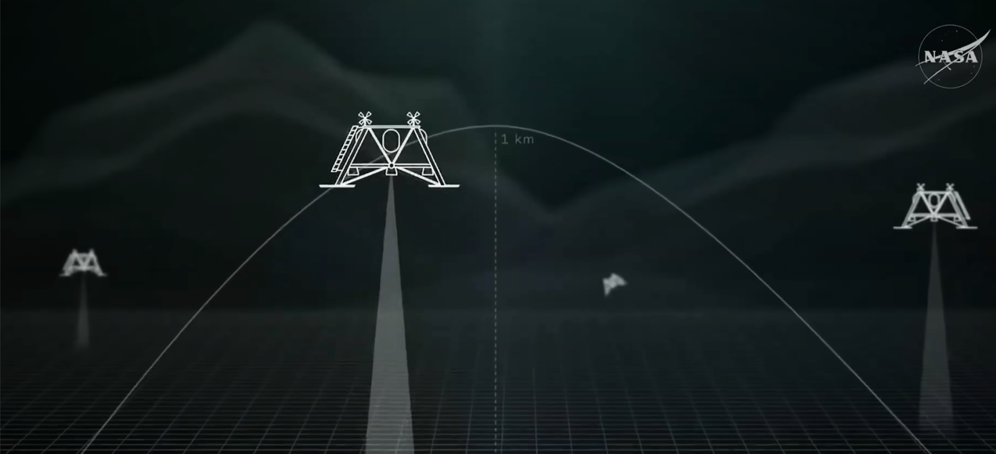
RAPID AUTONMOUS ENERGY DELEVERY
anis@chargebotic.com · chargebotic.com

Slide 5
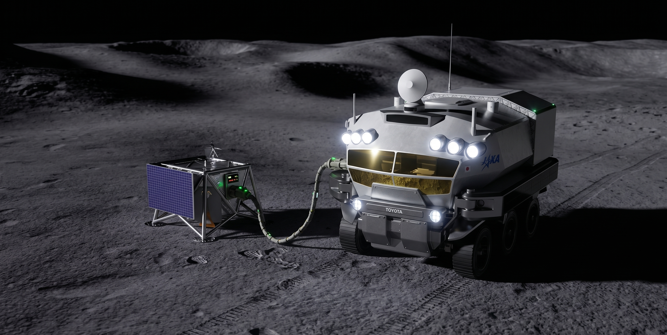
anis@chargebotic.com · chargebotic.com

Slide 6
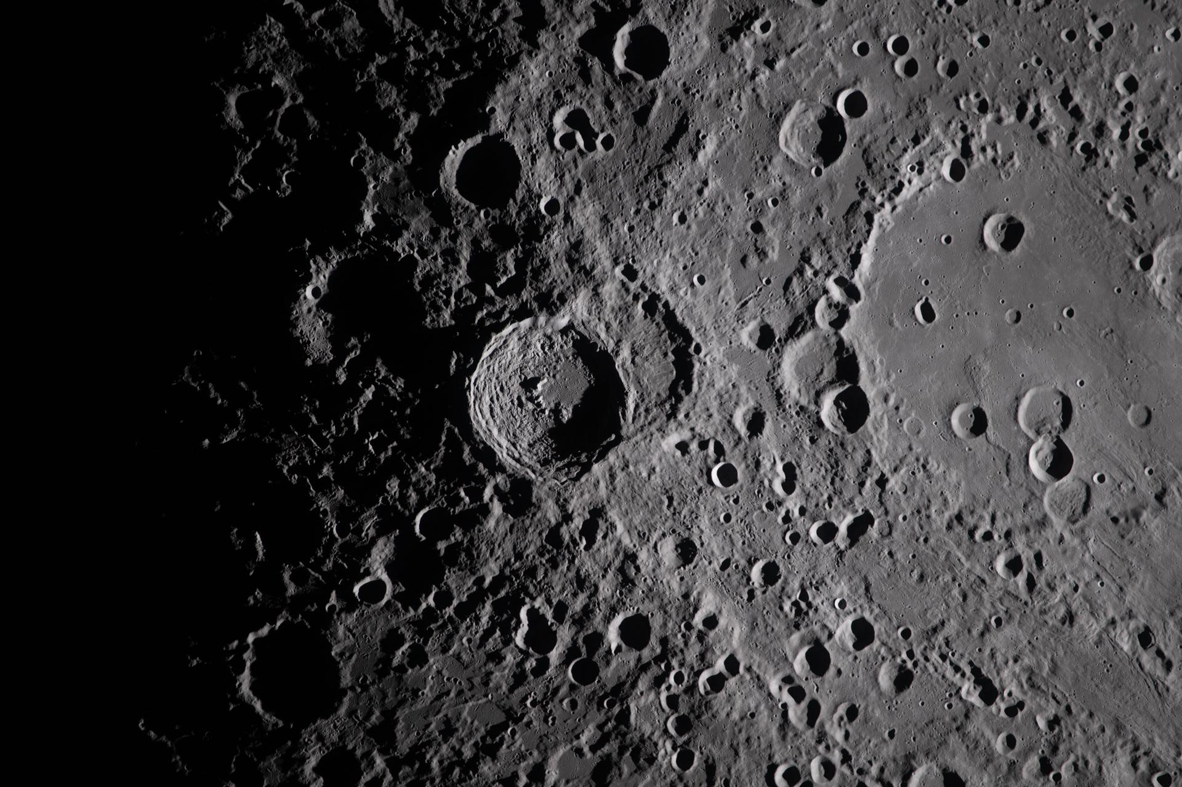
VEHICLE — 03
THE HOPPER
A charging station that comes to you.
A lightweight, foldable hopper that travels to stranded robots, delivers power, and returns to base to recharge.
500°KM
HARSH
Range per mission
Operates in rough terrain
RETURN
FOLDABLE
Self-recharges at base
Fits any cockpit payload
CHARGEBOTIC
anis@chargebotic.com · chargebotic.com
04 / 09

Slide 7
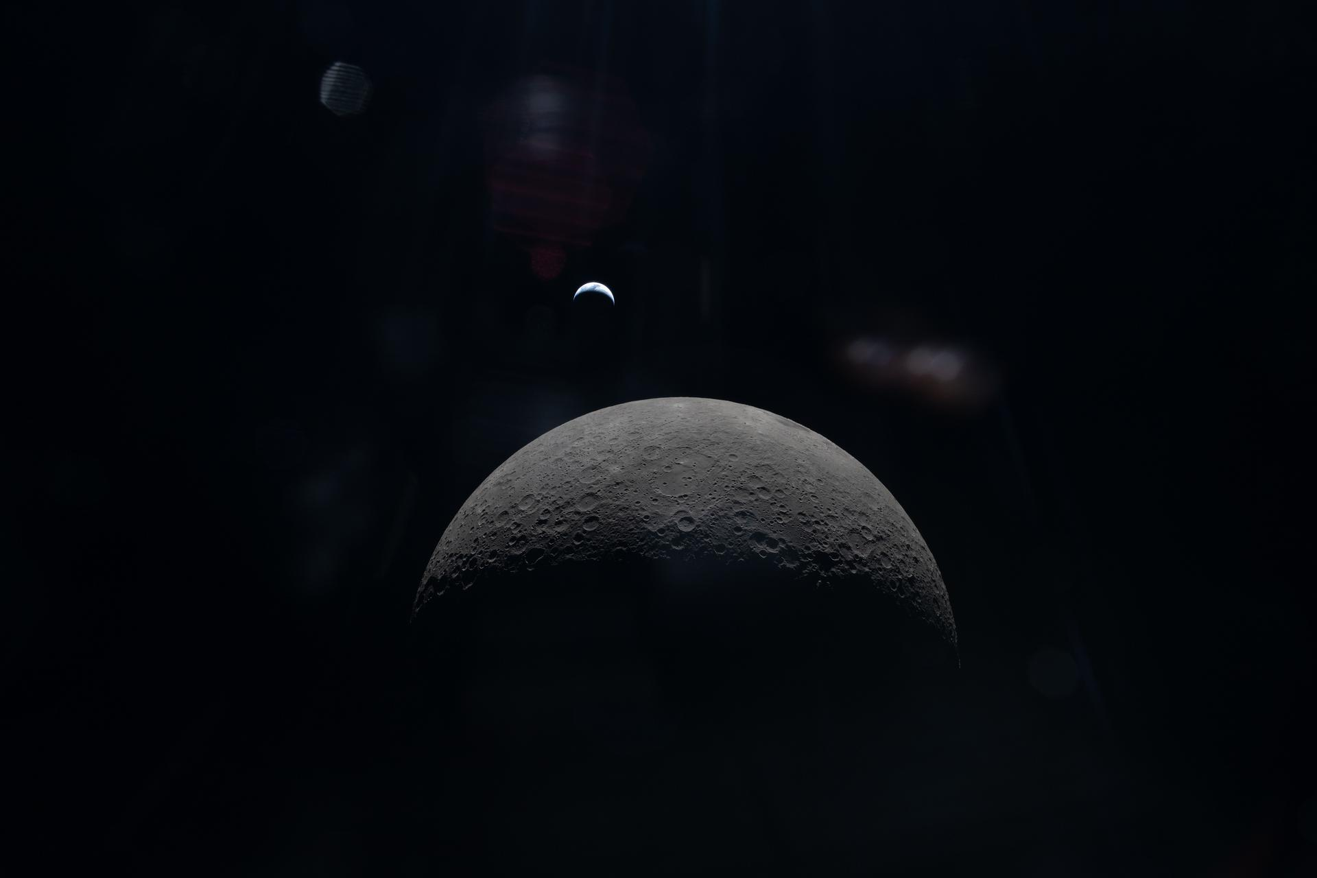
TRAJECTORY — 04
REVENUE & MARKET
Earth today Moon by 2029
Bootstrap revenue on Earth with general-purpose charging stations. Activate lunar market starting 2029.
◆ EARTH PHASE
◆ LUNAR ACTIVATION
$15B
$8000M
$1000M
$300M
$80M
$1M
2026
2027
2028
2029
2030
2031
CHARGEBOTIC
anis@chargebotic.com · chargebotic.com
05 / 09

Slide 8
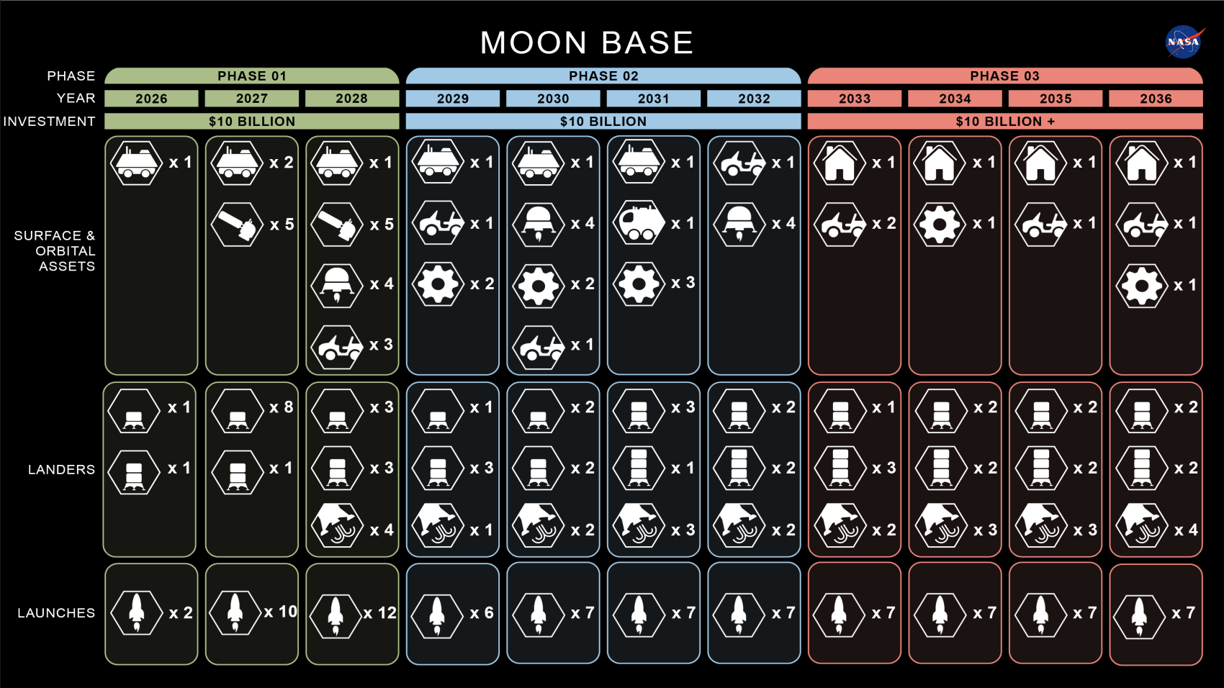
Official NASA data

Slide 9
OPERATION — 05
EARTH BEACHHEAD
Phase 2
NASA CLPS · Artemis · commercial lunar prime
Delivery energy to rovers, landers, and habitats on the lunar surface
Moon
Phase 1
Be the default Integrated charging solution for autonomous robots
Earth
(agriculture / AMR / UAV / defense / industrial / last-mile)

Slide 10
phase — 05
EARTH BEACHHEAD
Become the Plug & Play charging for robots on Earth.
A multipurpose charging station designed for the Nav2 ecosystem — the de facto navigation stack for mobile robots worldwide.
STRATEGIC PARTNERS
Steve Macenski
NAV2 / ROS 2
TECHNICAL ADVISOR — NAV2 LEAD MAINTAINER
Open-source standard powering mobile robots across agriculture, logistics, and defense. We ship a Nav2-compatible docking plugin plugs into any ROS 2 robot.
Advises us on technical direction and go-to-market into the robotics community
anis@chargebotic.com · chargebotic.com

Slide 11
MARKET — 06
GENERAL-PURPOSE ROBOTICS
$35K plug-and-play. Every robotics vertical.
TAM — $33.3B by 2033
Source: Allied Market Research, "Robot Charging Station Market," Sept 2024
15.8% CAGR from $7.8B (2023) base
URL: alliedmarketresearch.com/robot-charging-station-market-A323797
Same order of magnitude as the current "$38B" but actually defensible in diligence
SAM — ~$3.5B/year by 2030 (Nav2-compatible AMR fleet charging)
Math: 2.79M AMR shipments/yr by 2030 (ABI Research, Nov 2024) × 25% ROS 2 / Nav2-addressable × $5K avg charging-infra spend per robot
ABI source: abiresearch.com/press/mobile-robots-set-to-reach-28-million-shipments-by-2030
SOM — $25M–$75M 2028 revenue (1–3% SAM capture)
Low: 1% SAM → $25M, ~700 stations cumulative
High: 3% SAM → $75M, ~2,000 stations + SaaS tail
High case actually exceeds your current deck's $30M/2028 trajectory
CHARGEBOTIC
anis@chargebotic.com · chargebotic.com
07 / 09

Slide 12
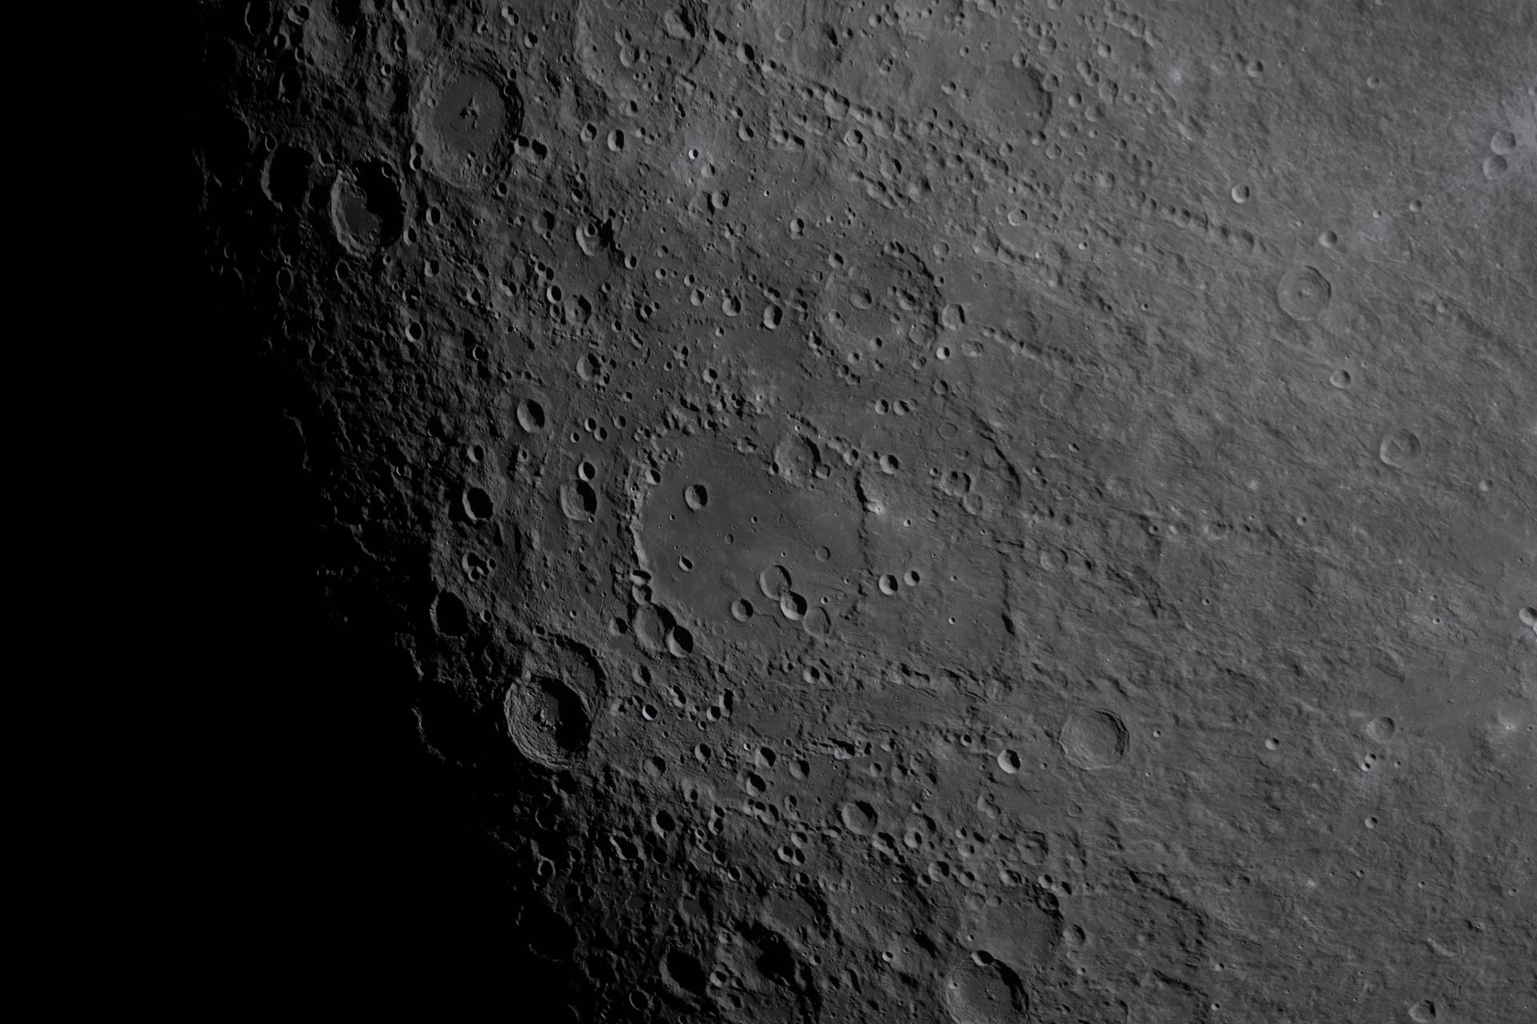
REQUEST — 07
THE ASK
Raising $2.2M.
6–12 months to production and go-to-market.
USE OF CAPITAL
WHAT $2.2M DELIVERS
Hardware R&D & production
45%
▸
Production-ready charging station
Pilot deployments & field tests
25%
▸
30 units built & deployed
▸
Pre-orders from 3+ robotics OEMs
Engineering hires (HW + SW)
20%
▸
Pilot data: agriculture + AMR
Operations & G&A
10%
▸
Line of sight to Series A
CHARGEBOTIC
anis@chargebotic.com · chargebotic.com
08 / 09

Slide 13
PERSONNEL — 08
THE TEAM
Operators, builders & advisors.
ANIS CHERIET
BO
STEVE MACENSKI
CO-FOUNDER · CEO
ENGINEERING (EX-APPLE)
NAV2 COLLABORATION
Energy systems & go-to-market.
Left Apple to build Chargebotic hardware.
Lead maintainer — ROS 2 navigation stack.
ARNE
PATRICK
HADI
ADVISOR
ADVISOR
ADVISOR
Strategic guidance
Strategic guidance
Strategic guidance
LET'S POWER THE NEXT CIVILIZATION · anis@chargebotic.com
CHARGEBOTIC
anis@chargebotic.com · chargebotic.com
09 / 09

